Slide 1
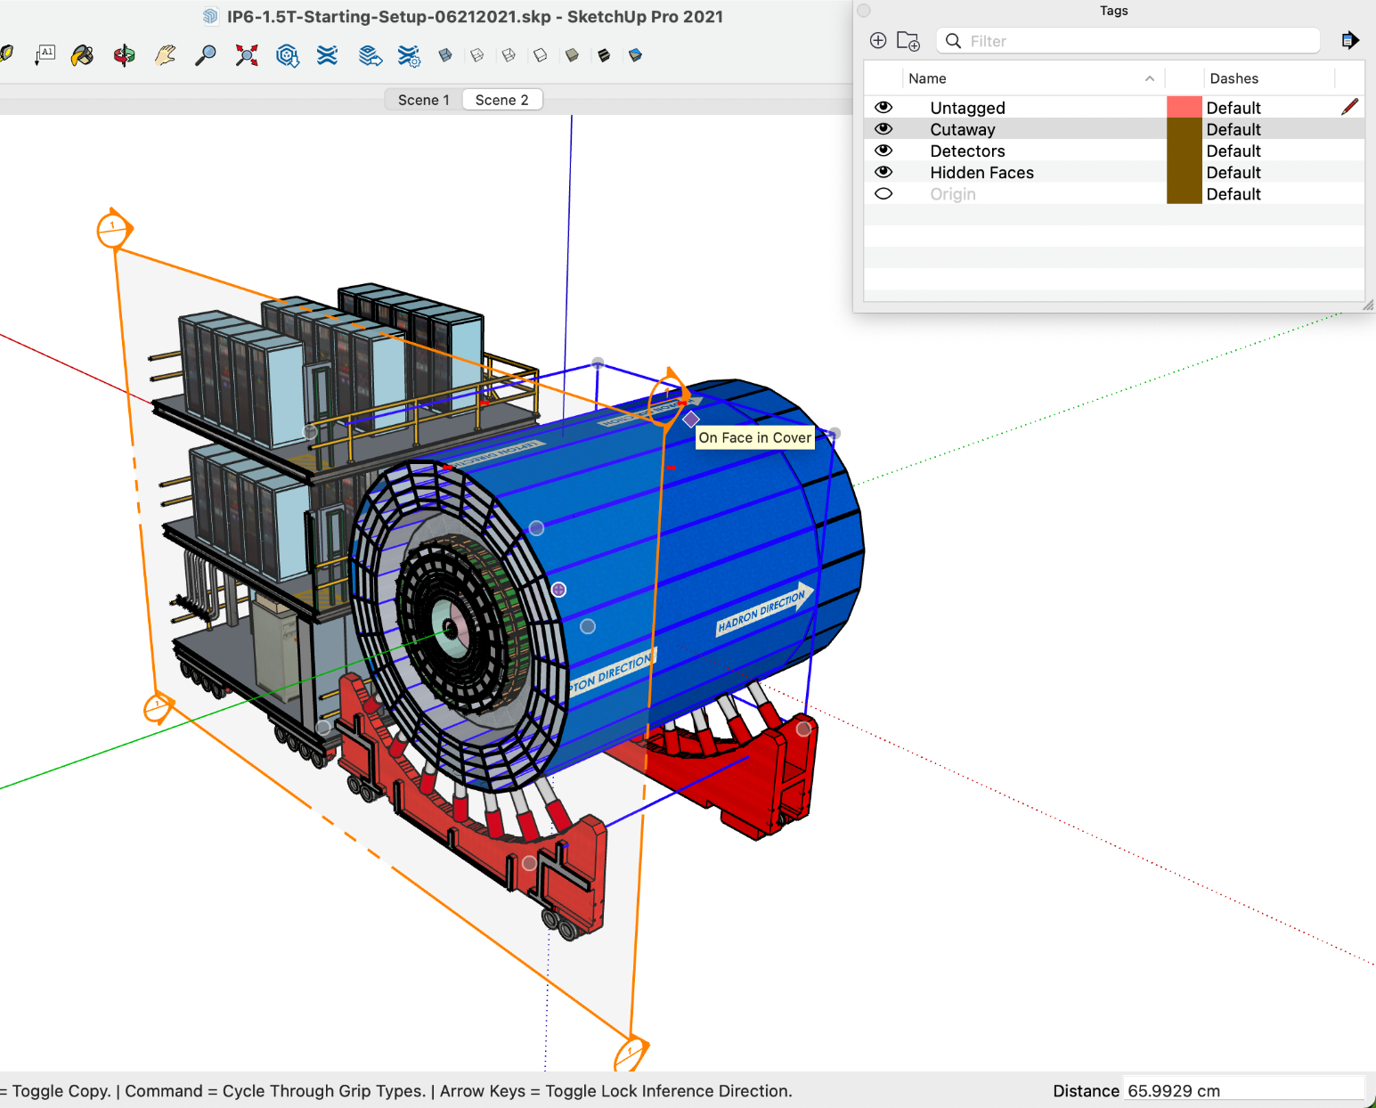
Creating Cross-Sectional Planes in SketchUp
Open SketchUp file of model
Go to Window -> Tags, then click the eye icon left of “Cutaway” to undo the original cut in the model, if necessary
Go to View -> Animation -> Add Scene -> Save as a New Style -> Create Scene
Make a section plane cut by clicking Tools -> Section Plane (or ⌘Y) and placing it on the desired plane or face
Use move tool (M) to drag the section plane and create the cut
Go to View -> Animation -> Add Scene -> Save as a New Style -> Create Scene to add the new scene
You can now toggle between the scenes (Scene 1 and Scene 2) at the top
Repeat steps 3-5 to create additional section plane cuts

Slide 2
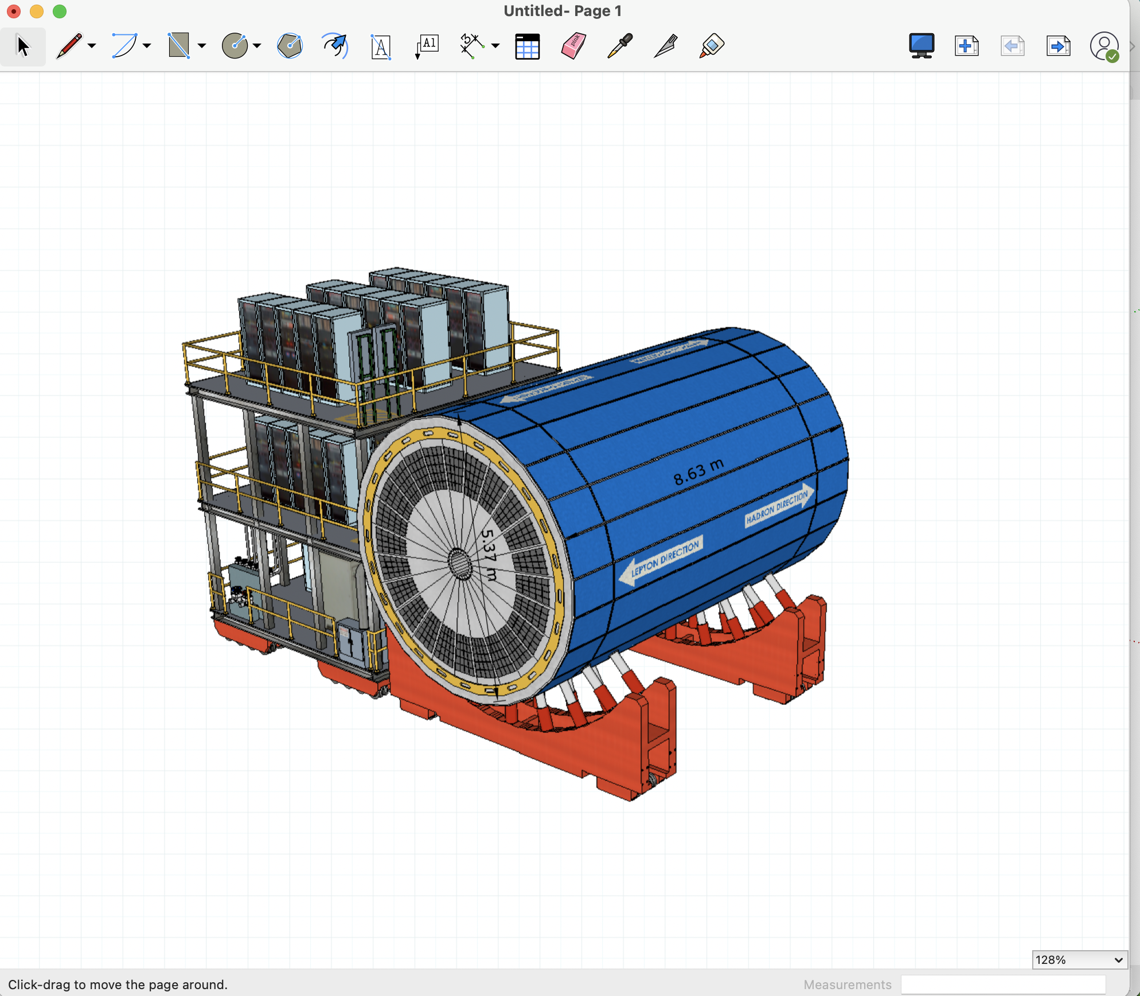
Adding Dimensions in LayOut
Once section plane cuts have been created in the scenes, click File -> Send to LayOut
Use the dimension tool (D) to add measurements to diagram
Right click model -> Style -> Construction Document Style to make section planes invisible
Right click -> Copy model
Add a new page and paste model
Right click -> Scenes -> select desired Scene (ex: “Scene 2”)

